Slide 1
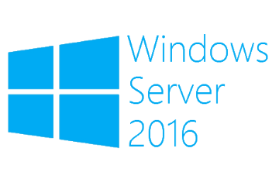
Clustered Scheduled Tasks
Megaseries

Slide 2
Intro
New feature in Windows Server 2012
These are normal scheduled tasks that are cluster aware and controlled by the cluster
Managed with Powershell
Run only as SYSTEM

Slide 3
Types
Any Node: When you create a task with this type it runs on one of the cluster nodes
Cluster Wide: The task created with this type runs on all nodes of the cluster
Resource Specific: The task created with this type runs on the cluster node that hosts a specific resource

Slide 4

https://www.youtube.com/channel/UCcZ-jLbPwNr8E_v9-65n8Iw https://github.com/itknowledge4

